Slide 1



AI Master Class series – Day 14
Leaf Disease Detection

Slide 2
Day-14 Agenda.
01.
02.
03.
Leaf Disease
Basic Syntax
Leaf Disease
04.
Q & A
Leaf disease & its Application
Basic Syntax for Leaf disease detection
Leaf disease detection

Slide 3
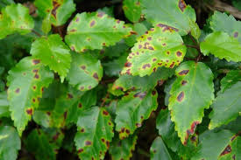
Leaf disease detection.
Plant disease identification by visual way is more laborious task and at the same time less accurate and can be done only in limited areas.
Whereas if automatic detection technique is used it will take less efforts, less time and more accurately. In plants, some general diseases are brown and yellow spots, or early and late scorch, and other fungal, viral and bacterial diseases.

Slide 4
Block Diagram – Workflow of Leaf disease detection.
Dataset Creation
Train, Test, Val
CNN Design
Pre-Processing
Training - Model
Load Model - Test
Pre-process Input Image
Classification

Slide 5

! PRACTICAL SESSION !

Slide 6
Leaf disease detection using Deep Learning

Slide 7
model = Sequential()
model.add(Conv2D(32, kernel_size = (3, 3), activation='relu', input_shape=(128,128, 3)))
model.add(MaxPooling2D(pool_size=(2,2)))
model.add(BatchNormalization())
model.add(Conv2D(64, kernel_size=(3,3), activation='relu'))
model.add(MaxPooling2D(pool_size=(2,2)))
model.add(BatchNormalization())
model.add(Conv2D(64, kernel_size=(3,3), activation='relu'))
model.add(MaxPooling2D(pool_size=(2,2)))
model.add(BatchNormalization())
model.add(Conv2D(96, kernel_size=(3,3), activation='relu'))
model.add(MaxPooling2D(pool_size=(2,2)))
model.add(BatchNormalization())
model.add(Conv2D(32, kernel_size=(3,3), activation='relu'))
model.add(MaxPooling2D(pool_size=(2,2)))
model.add(BatchNormalization())
model.add(Dropout(0.2))
model.add(Flatten())
model.add(Dense(128, activation='relu'))
model.add(Dropout(0.3))
model.add(Dense(25, activation = 'softmax'))

Slide 8
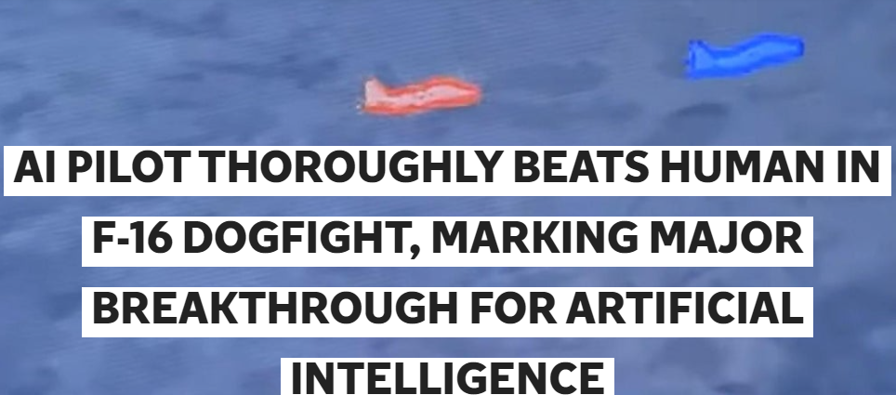
AI News – Day 14. 2020
An AI pilot has defeated a US Air Force pilot in a virtual F-16 dogfight in a "coming of age" moment for artificial intelligence.
The US military's AlphaDogfight Trials was organised by the Defense Advanced Research Projects Agency (Darpa) - a secretive branch of the US Department of Defense responsible for the development of futuristic technologies.
The winning AI pilot, developed by Heron Systems, defeated other AI adversaries before going on to beat a human pilot wearing a VR helmet by a score of 5 - 0 in the final.

Slide 9
Thanks!
Tomorrow session
Do you have any questions?
sanjay@pantechmail.com
www.pantechsolutions.net
Character recognition using CNN

